Slide 1

Bellabeat Smart Device Usage Analysis
Google Data Analytics Capstone Project
Prepared By: Sanjana Parihar
Tools Used :
SQL Server
Python (Pandas, NumPy, Matplotlib)
Tableau Public
Excel
Fitbit Fitness Tracker Dataset (Kaggle)

Slide 2
Business Task :
Objective :
Business Questions -
What are smart device usage trends?
How do users behave?
How can Bellabeat improve marketing?
Stakeholders
Urška Sršen (Co-Founder & Chief Creative Officer)
Sando Mur (Co-Founder)
Bellabeat Marketing Analytics Team

Slide 3
Data & Methodology
Dataset Used
Fitbit Fitness Tracker Data (Kaggle)
Files Analyzed
Daily_activity
Sleep_day
hourly_Steps
Analysis Process
Ask → Prepare → Process → Analyze → Share → Act
Workflow
Raw Data → SQL Cleaning → Python Validation → Tableau Dashboard → Business Recommendations

Slide 4
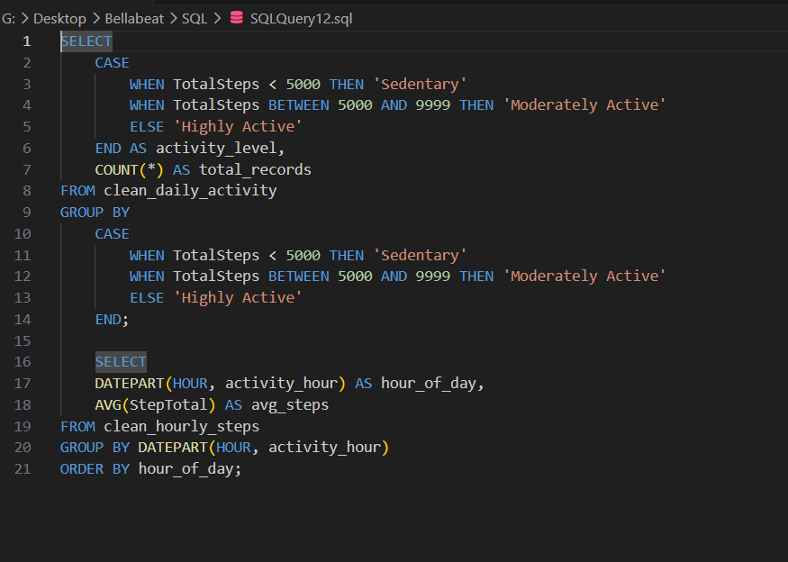
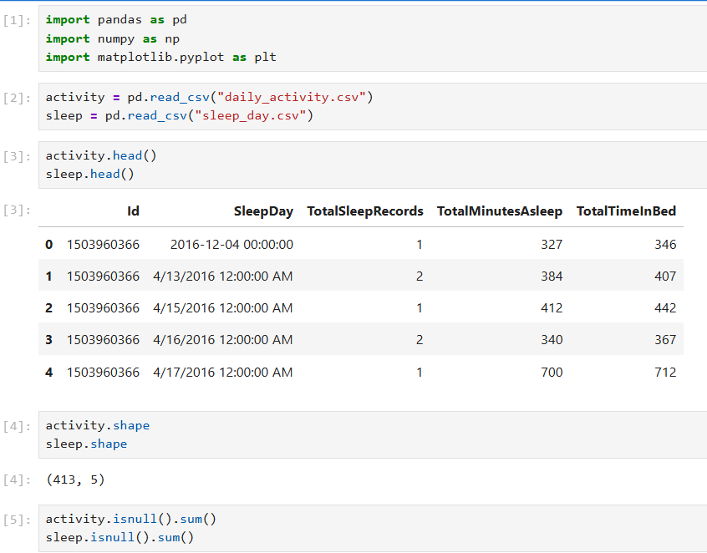
Data Preparation & Analysis
SQL Analysis
Imported Fitbit datasets into SQL Server
Checked duplicates and NULL values
Standardized date formats
Created clean tables and summary datasets
Analyzed activity, sleep, and hourly trends
Python Analysis
Imported data using Pandas
Converted date fields
Created Weekday and Sleep Hours features
Performed descriptive analysis
Calculated summary statistics
Validated SQL findings
Result
SQL and Python produced consistent findings, increasing confidence in the analysis.

Slide 5
Tableau Dashboard
Dashboard Components
Average Daily Steps
Average Calories Burned
Average Sleep Hours
Average Steps by Weekday
Calories vs Steps
Sleep Duration vs Steps
Activity Level Distribution
Average Steps by Hour
Purpose: Visualize user behavior, activity patterns, and wellness habits.

Slide 6
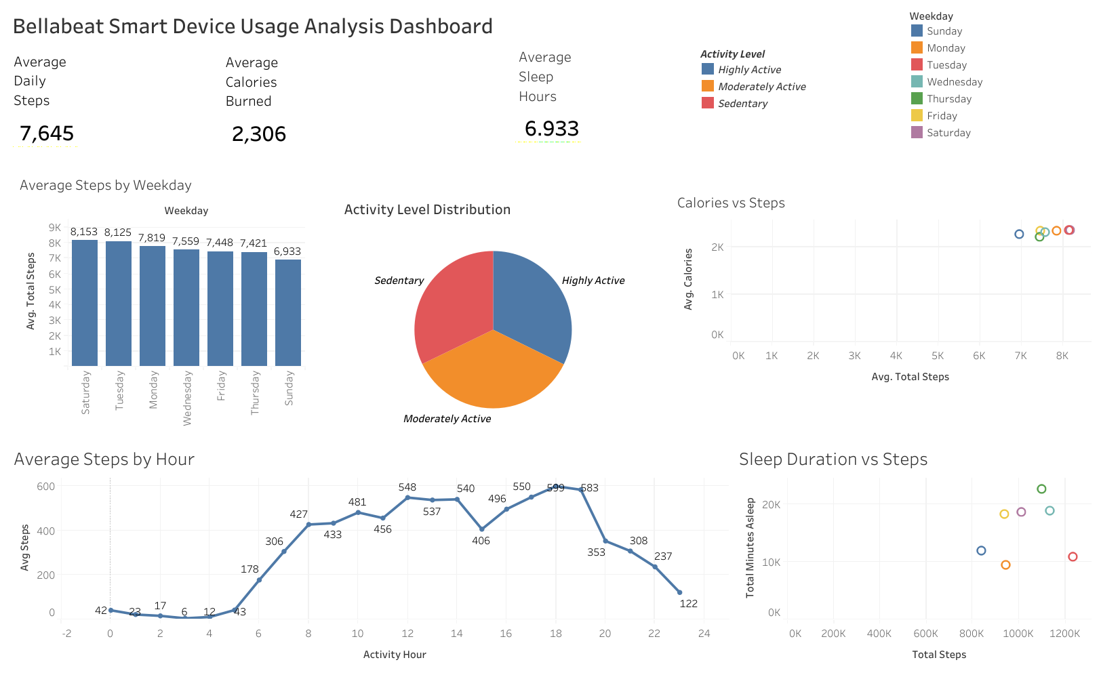

Slide 7
Key Findings
Activity & Wellness Trends
Average daily steps ≈ 7,600
Average sleep duration ≈ 7 hours
Most users do not consistently reach the 10,000-step goal
Higher step counts are associated with higher calorie burn
Activity levels vary across weekdays
User activity is highest on weekdays and Saturday
Peak activity occurs during daytime and evening hours
Validation
The same insights were observed in both SQL and Python analysis.

Slide 8
Recommendations & Conclusion
Recommendations
Introduce personalized step-goal challenges to encourage higher activity.
Send targeted reminders during peak engagement hours to improve user participation.
Promote Bellabeat's holistic wellness ecosystem by combining activity, sleep, and health insights.
Conclusion
The analysis revealed clear relationships between physical activity, calorie expenditure, sleep habits, and user engagement.
These insights can help Bellabeat improve customer engagement, increase retention, and develop more personalized marketing campaigns.

